Slide 1

Sustainable development and tourism
Kivennapa

Slide 2
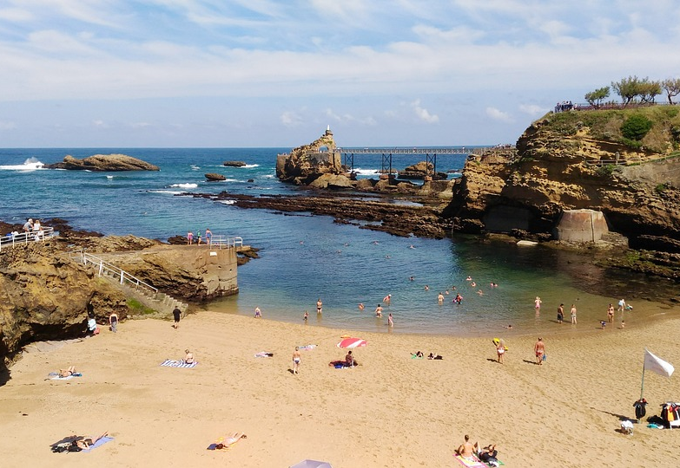
What is tourism?
Travelling to another country
Source of money to the destination country
For pleasure of discovering new places and cultures

Slide 3

What is sustainable development?
Prevent the degradation of Earth
Being responsible with the nature
Finding better ways to live
Provide money to local inhabitants

Slide 4
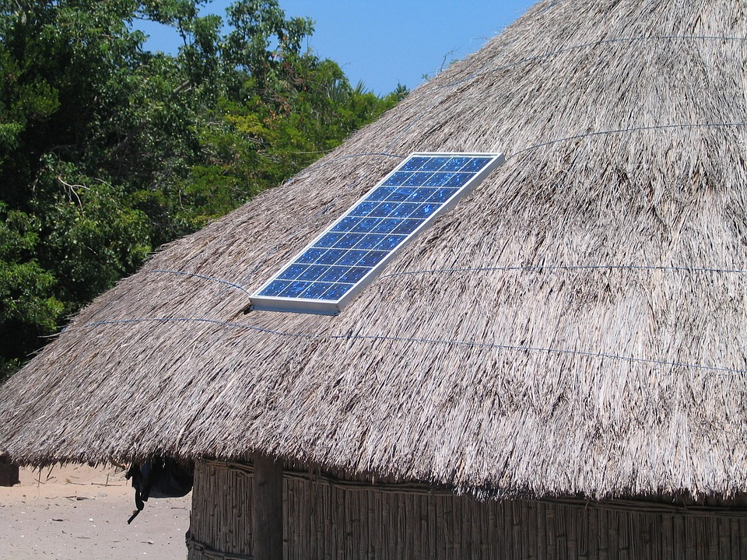
How tourism and sustainable development can be combined?
Ecological accommodation
Solar panels
Organic food
Travel thoughtfully
Walk, bike and use public transport when you can
Don't go by plane if you can use the train

Slide 5

Tourism's challenges for sustainable development
Respecting and adapting to other traditions
Different habits between countries, countries are used to different things
it brings less money because it's difficult to combine sustainable development and tourism
Our transport habits are damaging for the climate
Mass tourism is harming the environment by not respecting the destination

Slide 6
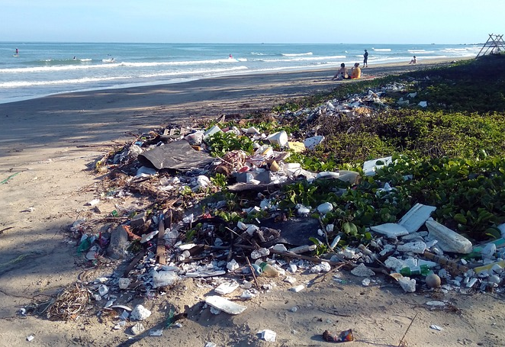
Why has sustainability become an important issue in tourism?
It's one of the main reasons of pollution and climate change

Slide 7

Basic info - Kivennapa
At kivennapa you can go to sauna, forest walk and stopping at goahti, marshmallow challenge and stretching, hundreds of years old "kyykkä" game and forest yoga.
Activities are for foreigners and Finnish tourists because it is easy to do for everyone.
Kivennapa operates at Muuruvesi.
Good place to spend time with big groups. Near to nature and respecting sustainable bevelopment.

Slide 8

Sustainable development in Kivennapa
They take care of the nature in their work by recycling
They provide advice on:
protecting the nature
not littering

Slide 9

Things to improve
The official site is not available in English
The site doesn't provide much information about sustainable development
The house should use more renewable energy, like solar panels

Slide 10

Promoting sustainable development
Ways for Kivennapa to further improve its operations to promote sustainable development:
On your website tell about what do you do for sustainable development
Educate your guests about responsible staying
Consequences for taking sustainable development into account:
You gain respect from people
It's trending -> brings customers
Helps the local communities
You might lose some money in the begining

Slide 11
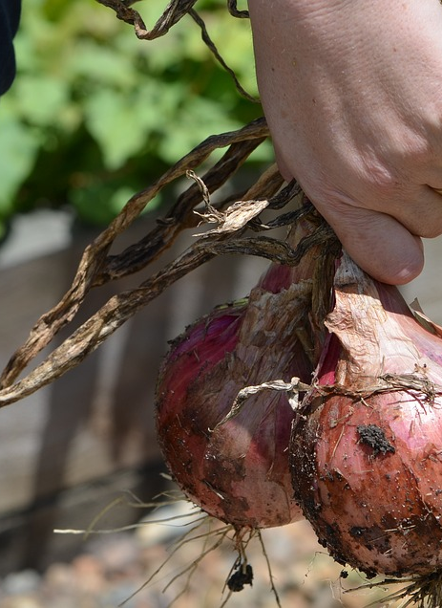
Company's way of combining sustainability and tourism:
-They use local food and grow their own veggies but they say nothing else about it on the website
If a company doesn't follow sustainability development:
-At first it will benefit the company because it brings more money
-It can harm it because people won't use it if it hurts the planet

Slide 12

Our view
Sustainable development and tourism are good things but we hope that the tourists would respect and not litter our nature.
Kuopio is quite a big city and lots of tourists visit here so it's important to tell that protecting nature and environment is important.

Slide 13
Sources:
https://www.pixabay.com
https://www.kivennapa.com/

